Slide 1


Year 1 Writing Workshop
Helping your child to start their journey as a writer
Tuesday 13th October 2026
Roe Green Infant and Nursery School
Notes:
Welcome. Explain that today is about practical things families can do at home, and that parents will be the class for a few games and activities. Every slide will be on the school website afterwards.

Slide 2







What we will cover today
Most of today is about simple things you can do at home.
1
2
3
4
5
Writing in Year 1
Say it first
Sentence games
Retell a story
Help at home
What your child learns and the books we use.
A simple routine for every sentence.
Have a go yourselves: you are the class today!
Tell it, map it, then change one thing.
Spelling, handwriting and everyday writing.
All of these slides will be on our school website, so you do not need to write anything down.
Notes:
Quick overview. Tell parents that there will be games where you ask them for answers, just as you would in class.

Slide 3










Writing is hard work!
Every time your child writes, they are juggling all of these things at once.
Ideas
Think of what to write
Memory
Hold the sentence in their head
Pencil control
Hold and move the pencil
And that is just the start!
Letters
Form each letter the right way
Phonics
Match sounds to letters
Spacing
Leave a space between words
One good sentence is a real achievement in Year 1.
Short, happy bursts of writing work best.
Praise the ideas and the effort, not just neat handwriting.
Grammar
Put words in the right order
Punctuation
Remember capital letters and full stops
Vocabulary
Choose the best word
Notes:
Ask parents: "Think back to learning to drive. How many things did you have to think about at once?" Writing feels the same for a five- or six-year-old. This is why patience and praise matter so much.

Slide 4


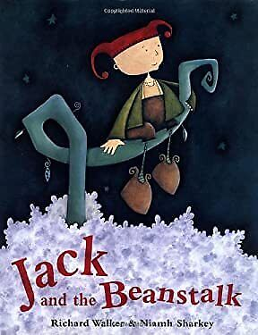
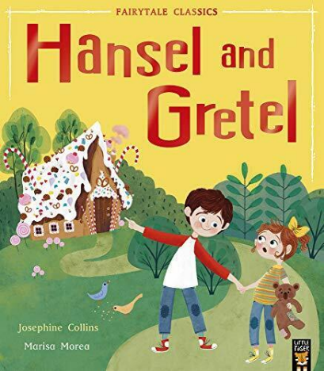

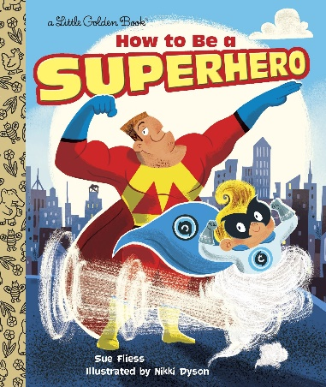

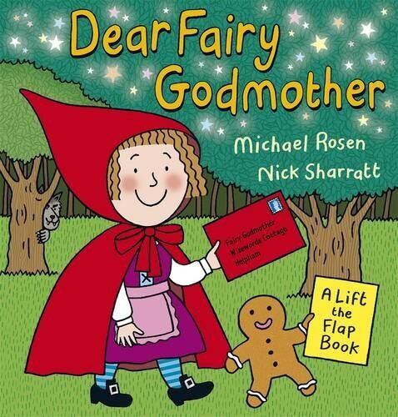



What your child will write in Year 1
Year 1 writing is short and often based on stories your child already knows well.
Fiction
Made-up stories
Non-fiction
Real information
Retelling stories
Changing a story
Labels and captions
Lists
Diaries
Character descriptions
Recounts of trips
Instructions and recipes
Poems and rhymes
Information
Letters and postcards
Notes:
Other books this year include Nursery Rhymes, Looking after Rabbits, Bob’s Alien Spotter’s Guide, The Rascally Cake and Flip Flap Ocean. Each unit starts with a quality book that we read, talk about and act out before writing.

Slide 5

Say it, count it, write it, check it
A simple routine for every sentence your child writes. "If you can say it, you can write it."
SAY IT
COUNT IT
WRITE IT
CHECK IT
1
2
3
4
Your child says the whole sentence out loud, then says it again.
Count the words on your fingers: one finger for each word.
Write one word at a time, using phonics. Leave a finger space after each word.
Read it back, pointing to each word.
You say:
"Tell me your sentence."
You say:
"How many words are in your sentence?"
You say:
"What is the next word? Use your sounds."
You say:
"Capital letter? Finger spaces? Full stop?"
Try it now: "The hen found some wheat." Say it together and count it: five words, five fingers!
Notes:
Do this with the parents: say "The hen found some wheat." together, then count the words on your fingers. The counting helps children remember the sentence while they spell each word, and stops words being missed out.

Slide 6
The silly sentence game
ACTIVITY
Pick one card from each column and say the sentence. The sillier, the better!
Who?
+
What?
+
Where?
A giant
danced
on the moon
The little red hen
sneezed
in the bath
My teacher
ate a cake
under the bed
A hungry crocodile
fell asleep
at school
Grandad
did a cartwheel
up a beanstalk
For example: A hungry crocodile did a cartwheel on the moon.
Notes:
Ask a few parents to pick one from each column and say their sentence. Then write one on the board together, using Say it, Count it, Write it, Check it. At home: write the cards on scraps of paper, put them in three cups and take turns to pick. Your child then writes their favourite sentence and draws a picture of it.

Slide 7

Make it a super sentence
ACTIVITY
In Year 1, we add a describing word and join ideas with "and".
Start here
Jack climbed the beanstalk.
Add a describing word
Jack climbed the tall beanstalk.
Join it with "and"
Jack climbed the tall beanstalk and he saw a giant castle.
Your turn! Make this a super sentence:
The hen found some wheat.
What kind of hen? What did she do next? Join it with "and".
Notes:
Reveal each line, naming what has been added. Then take ideas for the hen sentence and build it on the board. One possible answer: "The little red hen found some golden wheat and she planted it in the ground." In Year 2, children go on to use joining words such as because, when and but.

Slide 8


Be a sentence detective
ACTIVITY
Can you spot what is missing? Shout out what needs fixing.
Case 1
Detective clues
on monday jack and i went to the park
A capital letter at the start?
How many mistakes can you find?
Capital letters for names and days?
A capital letter for "I"?
Case 2
thehenfoundsomewheat
Finger spaces?
A full stop at the end?
What is missing here?
At home: write a sentence with mistakes on purpose. Can your child catch you out?
Notes:
Let parents call out the mistakes. Case 1 has five: capital O for "On", capital M for "Monday", capital J for "Jack", capital I, and a full stop at the end. Case 2 needs a capital T, finger spaces between the words and a full stop. The answers are on the next slide.

Slide 9

Case solved! The Year 1 punctuation checklist
On Monday Jack and I went to the park.
The hen found some wheat.
Finger spaces between every word
A
↔
.
?
!
Capital letters
Finger spaces
Full stops
Question marks
Exclamation marks
Start of a sentence, names, places, days of the week and "I"
A space the size of a finger between words
At the end of every sentence
Where is the little red hen?
Help! What a big castle!
Coming in Year 2: commas in lists and apostrophes.
Notes:
Go through the corrections. The most common Year 1 slip is forgetting capital letters for names and for "I". A quick check at home: ask your child to point to every capital letter and full stop in their sentence.

Slide 10
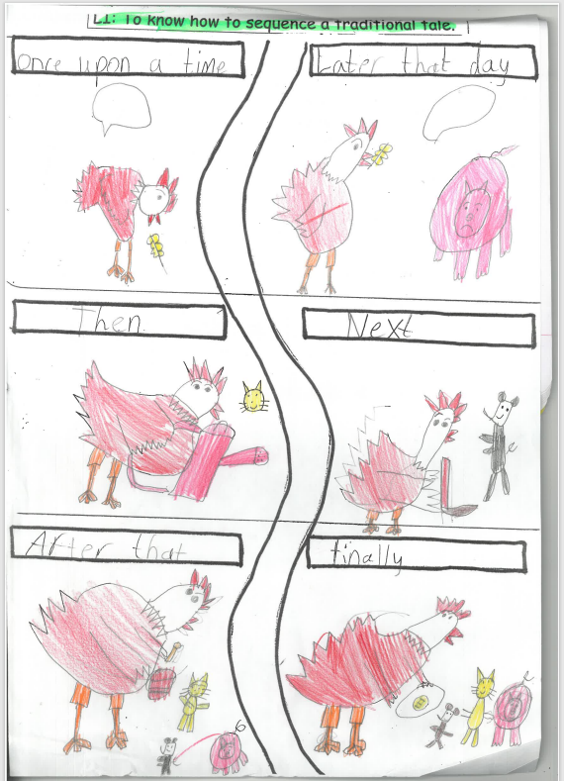
Retell it: tell it, map it, act it
In Year 1, children learn a story off by heart before they write it.
1
Read the story lots of times. Join in with the repeated lines: "Not I," said the cat.
2
Draw a story map together: one simple picture for each part of the story.
3
Act it out with an action for each part. Point to the map as you go.
4
Use time words to move the story on (see below).
5
Write it one picture at a time, saying each sentence first.
Time words
Once upon a time
First
Next
Then
After that
Finally
Notes:
This story map was drawn by one of our Year 1 children. Notice the time words in the boxes: Once upon a time, Later that day, Then, Next, After that, Finally. Children retell the story many times, with actions, before writing it.

Slide 11

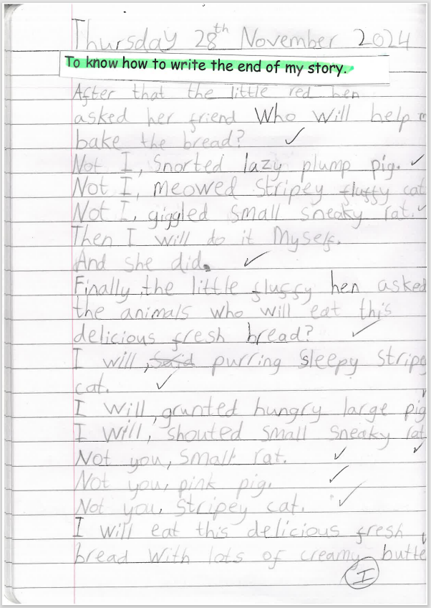


Change one thing
ACTIVITY
Once your child knows a story well, change a character or the ending to make it their own.
The story so far
The little red hen asks the other animals to help her make bread. They all say "Not I!", so she does it all herself.
Change a character
Who else could the hen ask? A sleepy cat? A grumpy goat?
What would they say? How would they say it?
?
Change the ending
What if the animals helped after all?
What if the hen shared the bread? What would happen next?
?
A Year 1 child’s new version: "Not I," snorted lazy plump pig.
Notes:
Take ideas from parents for new characters and new endings. Point to the child’s writing on the right: they kept the pattern of the story but added their own describing words and new endings. In Year 2, children go further and plan whole new stories.

Slide 12



Games for describing words
ACTIVITY
In Year 1, children start to use describing words (adjectives). These games build them.
Feely bag
What am I?
Describing I spy
Hide an object in a bag. Your child feels it without looking and describes it.
Describe something in the room without saying its name. Can they guess? Then swap.
Play I spy with a describing word instead of a letter.
"It is soft and squishy."
"I am round, red and crunchy."
"I spy something shiny."
Year 1: one describing word
a soft teddy
Year 2: two describing words
a soft, brown teddy
Then write it: turn the best describing word into a sentence. "I have a soft teddy."
Notes:
Bring a feely bag with an object inside. Ask a parent to feel it and describe it to the room without saying what it is. Everyone else guesses. These games are about talk first: once a child can say a describing word, they can write it.

Slide 13
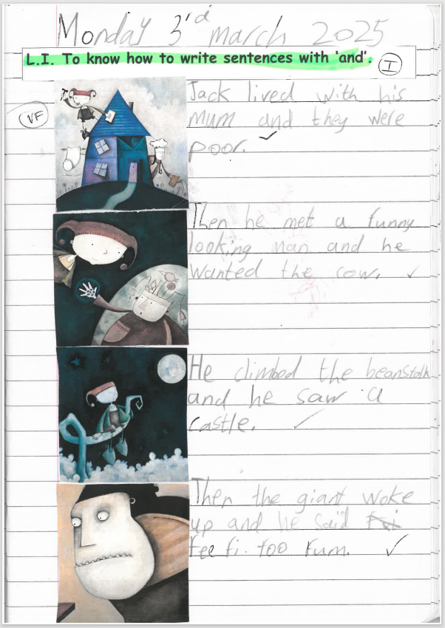
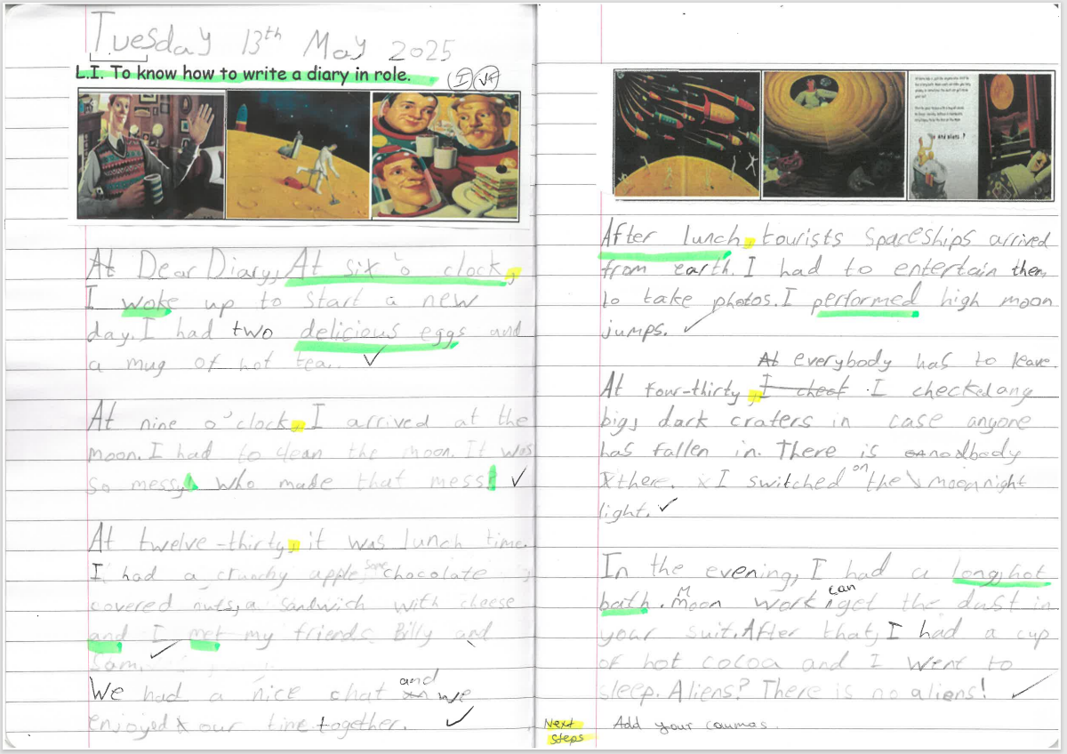
What Year 1 writing looks like
Real work from our Year 1 children. Notice how much it grows during the year.
Look out for
Capital letters and full stops
Finger spaces
Ideas joined with "and"
Describing words
Time words: After lunch, In the evening
Phonics spellings that are a good try
Spring: sentences joined with "and"
Summer: a diary written in role, with time words and describing words
Notes:
These are real pieces from Year 1. The first shows the start of longer writing: four sentences retelling Jack and the Beanstalk, joined with "and". The second, from the summer term, is a diary in role. Point out that not every word is spelt correctly, and that this is normal and expected in Year 1.

Slide 14


Spelling: use your sounds
In Year 1, we want children to have a go using phonics. A good try is something to praise!
1
Say the word slowly.
Year 1 common exception words (45)
the
a
do
to
today
of
2
Count the sounds on your fingers: sh-i-p is 3 sounds.
said
says
are
were
was
is
Write the letters for each sound, in order.
his
has
I
you
your
they
3
be
he
me
she
we
no
4
Read it back. Does it look right?
go
so
by
my
here
there
where
love
come
some
one
once
Praise first, then teach
Your child writes "I went to the beech." Great phonics! Then show them: "In beach, we use ea for that sound."
ask
friend
school
put
push
pull
full
house
our
Also in Year 1: the days of the week, and adding s or es (hens, foxes).
Notes:
Common exception words cannot be sounded out in the usual way, so children learn them by heart. Practise 3 to 5 at a time, little and often. Year 1 children are also taught to spell the days of the week, and to add -ing, -ed, -er and -est where the root word does not change.

Slide 15

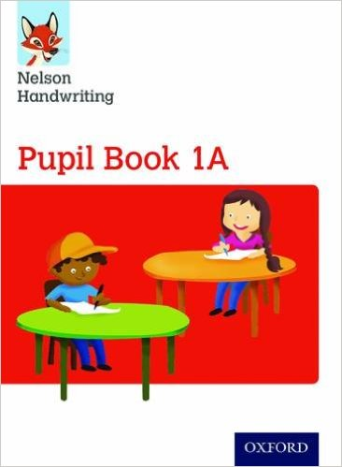
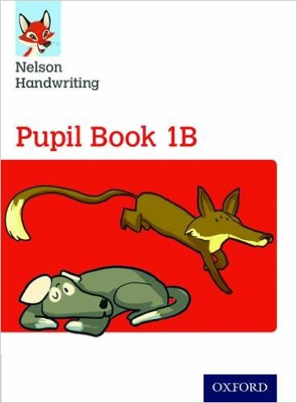





Handwriting: getting letters right
We use Nelson Handwriting. Book 1A teaches every letter; Book 1B begins joining.
Hold the pencil correctly: pinch with the thumb and first finger, resting on the middle finger.
Start in the right place: most letters start at the top. Watch how your child forms each one.
Lower case first: capital letters only at the start of sentences and for names.
Build strong fingers: playdough, pegs, threading beads and tearing paper all help.
Make it fun: write letters in sand, shaving foam, with chalk, or with water and a brush.
Letter families
These letters all start with the same curly movement, like c.
Start at the green dot. Go over the top and round. For a, d, g and q, go back up and then down.
Notes:
The letters are drawn in a Sassoon-style hand to match Nelson: single strokes, with exit flicks on a and d. The green dot shows where to start and the red arrows show the direction. Every one of these letters starts like c, just below the top on the right, and goes anticlockwise over the top. Children also learn capital letters and the digits 0 to 9. In Year 2, joins become more fluent.

Slide 16
Grammar words your child will use
You do not need to teach these, but it helps to know what your child is talking about!
Noun
Verb
Adjective
Joining word
A naming word.
A doing word.
A describing word.
Joins two ideas together.
hen, Jack, school
run, jump, climbed
big, red, fluffy
and
Plural
Prefix: un
Suffixes
Comparing
More than one: add s or es.
Added to the start. Means "not".
Added to the end.
Add er and est.
hen → hens, fox → foxes
kind → unkind, lock → unlock
help → helping, helped, helper
quick → quicker → quickest
Notes:
These are taught through the Nelson Grammar scheme (Pupil Books 1A and 1B). Keep this brief.

Slide 17









Little bits of writing, every day
In Year 1, short and often is best. A label or one sentence counts!
Labels
Label toys, boxes or rooms: "Sam’s room".
Captions
A sentence under a photo or a drawing.
It does not have to be a pencil!
Shopping lists
Your child writes three things you need.
Cards
"Dear Nana, thank you for my ..."
magnetic letters
chalk on the path
Fridge notes
Leave each other short messages.
Weekend news
"On Saturday I went to the park."
a finger in sand
a whiteboard
paint
a tablet
Let them see you write
Lists, notes and cards. Talk about what you are writing.
Praise every try
Talk about their ideas before spelling or neatness.
Your home language counts
Talking about ideas in any language helps writing.
Notes:
Keep it short and real. A label on a toy box or one sentence about the weekend is exactly the right size for Year 1. Writing with chalk, magnetic letters or a finger in sand still practises letter shapes and spelling.

Slide 18


Looking ahead: from Year 1 to Year 2
Everything your child learns this year is a building block for Year 2.
Year 1: this year
Year 2: next year
Sentences
Say a sentence, then write it. Short pieces of a few sentences.
Longer pieces, with sentences that follow on from each other.
Joining words
and
because, when, if, that, but, or
Describing
One describing word: a big castle
Two or more: the tall, dark trees
Punctuation
Capital letters, full stops and finger spaces. Some ? and !
Commas in lists, apostrophes and four kinds of sentence
Stories
Retell a story they know and change one thing
Plan and write new stories, characters and settings
Spelling and handwriting
Phonics and 45 tricky words. Form every letter correctly; first joins.
Spelling patterns and 64 new words. Joins become fluent.
Notes:
This slide is the same one parents will see at the Year 2 workshop next year. It shows that Year 1 skills are the foundations for everything that follows.

Slide 19

Your Year 1 writing toolkit
Little and often is the secret. Try some of these every week.
Say it, count it, write it, check it.
Play the silly sentence game.
Add a describing word and join with "and".
Be a sentence detective.
Retell stories with a story map and actions.
Change one thing: a character or the ending.
Spell with sounds. Praise a good try!
Write little and often: labels, lists, cards.
Notes:
A one-page summary. Parents may like to screenshot or print this slide from the website.

Slide 20

Any questions?
Thank you for coming, and for everything you do to help your child write.
You are always welcome to speak to your child’s class teacher about their writing.
These slides are on our website: rgreeninf.brent.sch.uk
Notes:
Open the floor to questions.

