Slide 1


Year 2 Maths Workshop
Helping your child become a confident, flexible mathematician
Monday 12th October 2026
Roe Green Infant and Nursery School
Notes:
Welcome. Today is about how we teach maths in school, so that you can use the same methods and language at home. Parents will be the class for a few activities. Every slide will be on the school website afterwards.

Slide 2







What we will cover today
Most of today is about simple things you can do at home.
1
2
3
4
5
How we teach
Tens and ones
Add and subtract
Times tables
Help at home
Build it, draw it, write it, say it.
Place value: the key to Year 2.
Number lines, bar models and using facts.
Multiplying, dividing and fractions.
Games, everyday maths and websites.
All of these slides will be on our school website, so you do not need to write anything down.
Notes:
Quick overview. Explain that there will be activities where you ask parents for answers, just as you would in class.

Slide 3



Building on Year 1
Your child is building on everything they learnt in Year 1.
Year 1: last year
Year 2: this year
Place value
Count to 100. See teen numbers as 1 ten and some ones.
Tens and ones to 100. Compare with < > =
Number facts
Number bonds to 10 and 20
Use facts to work out more: 3 + 7 = 10, so 30 + 70 = 100
Adding and subtracting
Within 20: count on, count back, part-whole
Two-digit numbers: tens and ones, number lines
Multiplying and dividing
Equal groups, arrays and sharing. Count in 2s, 5s, 10s
2, 5 and 10 times tables, using × ÷ and =
Fractions
Halves and quarters
Thirds, quarters and three quarters
Money and time
Coins and notes. O’clock and half past
£ and p, and change. Time to 5 minutes
Notes:
This is the same slide parents saw at the Year 1 maths workshop, with Year 2 now highlighted. Number bonds from Year 1 are the most important thing to keep practising.

Slide 4



Build it, Draw it, Write it, Say it
This is how every new idea is taught at Roe Green, from Nursery to Year 2.
Build it
(Concrete)
Draw it
(Pictorial)
Write it
(Abstract)
Say it
(Explain it)
Use real objects: cubes, counters, base 10.
Draw what you built: dots, lines, models.
Write it with numbers and symbols.
Talk it through, at every stage.
"2 tens add 1 ten is 3 tens."
"4 ones add 3 ones is 7 ones."
"So 24 add 13 is 37."
24 + 13 = 37
24 and 13 in base 10
Tens as lines, ones as dots
Going back to objects is not a step backwards. It is how real understanding is built, even for confident children.
Notes:
Parents may remember this from the Year 1 workshop, now with bigger numbers. The same four stages are used for every new idea in Year 2. Show real base 10 if you have it.

Slide 5


Maths may look different from your school days
"That is not how we do it!" Sound familiar? Here is why, and what to do.
You may have learnt ...
Your child is learning ...
A method to follow, step by step
Column sums, early on
To get the answer, without explaining it
Why it works, with objects and pictures first
Tens and ones first; column sums come in Year 3
More than one way, and to explain their thinking
When your child says "That is not how we do it!"
Ask them to show you
Let them be the teacher, using objects or a drawing.
Use their words
Parts and whole; tens and ones; count on; equal groups.
Share yours afterwards
Call it "another way", not "the right way".
1
2
3
Please avoid saying "I was never good at maths". Children pick up our attitudes. "Let us work it out together" is perfect.
Notes:
This answers the most common worry from parents. The column method is taught in Year 3, once children truly understand tens and ones. If it is taught too early, children learn steps without understanding them, and mistakes are hard to spot.

Slide 6

Tools we use in Year 2, and what to use at home
You do not need to buy anything. Everyday objects work just as well.
Base 10 (Dienes)
Place value chart
Hundred square
Tens | Ones
3 | 4
1 | 2 | 3 | 4 | 5 | 6 | 7 | 8 | 9 | 10
11 | 12 | 13 | 14 | 15 | 16 | 17 | 18 | 19 | 20
21 | 22 | 23 | 24 | 25 | 26 | 27 | 28 | 29 | 30
31 | 32 | 33 | 34 | 35 | 36 | 37 | 38 | 39 | 40
41 | 42 | 43 | 44 | 45 | 46 | 47 | 48 | 49 | 50
34 = 3 tens and 4 ones
At home: Bundles of 10 straws or lolly sticks
At home: Draw two columns on paper
At home: Print one: spot patterns
Empty number line
Bar model
Arrays
+10
20
+3
13
7
24
34
37
At home: Draw one on any scrap of paper
At home: Strips of paper
At home: Egg boxes, muffin trays, Lego
Notes:
If possible, have base 10 on the tables. Point out how the hundred square shows place value: moving down one row adds 10, so 24, 34, 44.

Slide 7
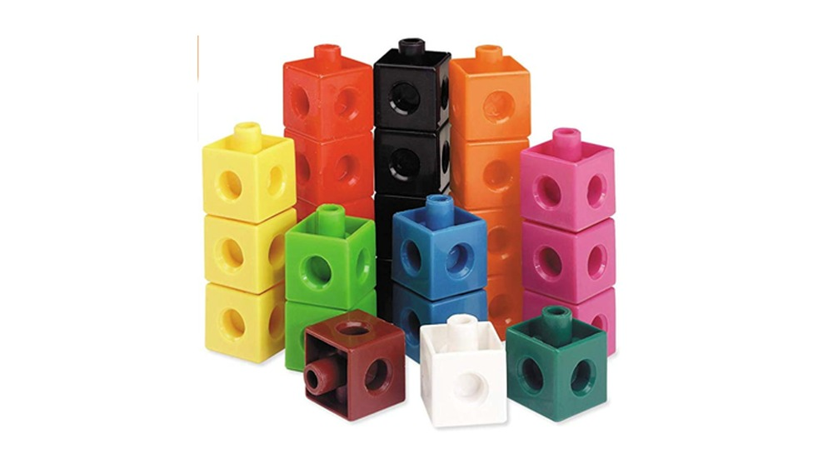
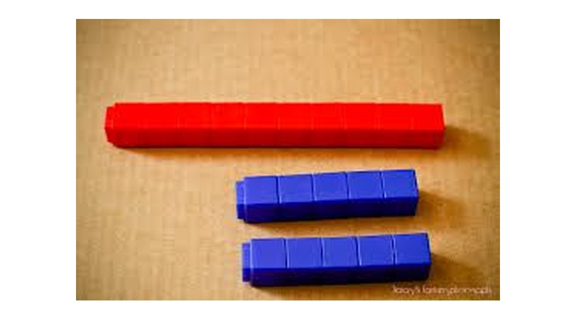
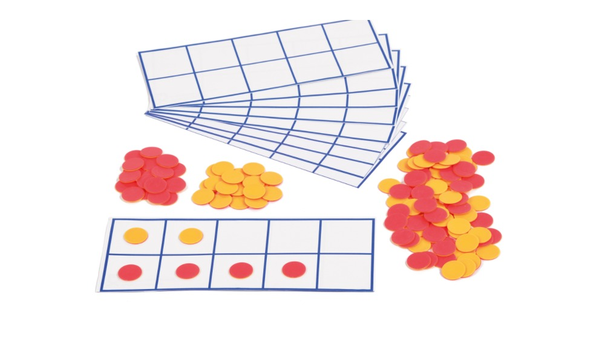
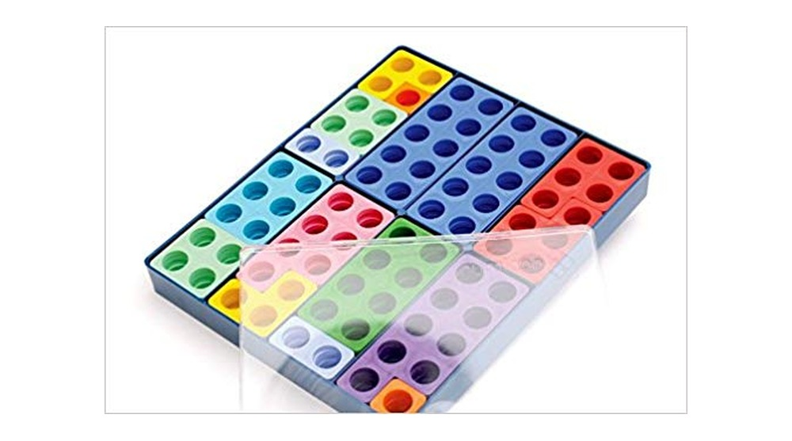
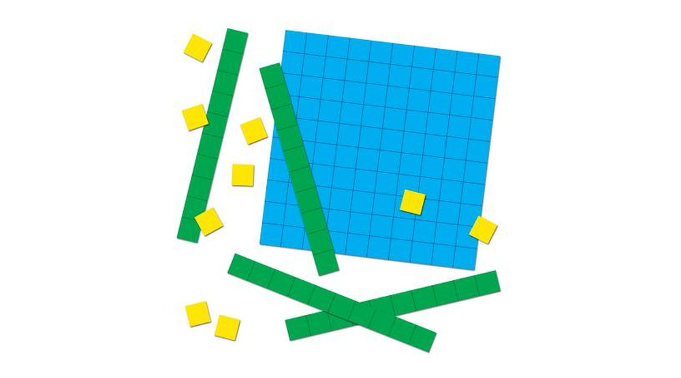
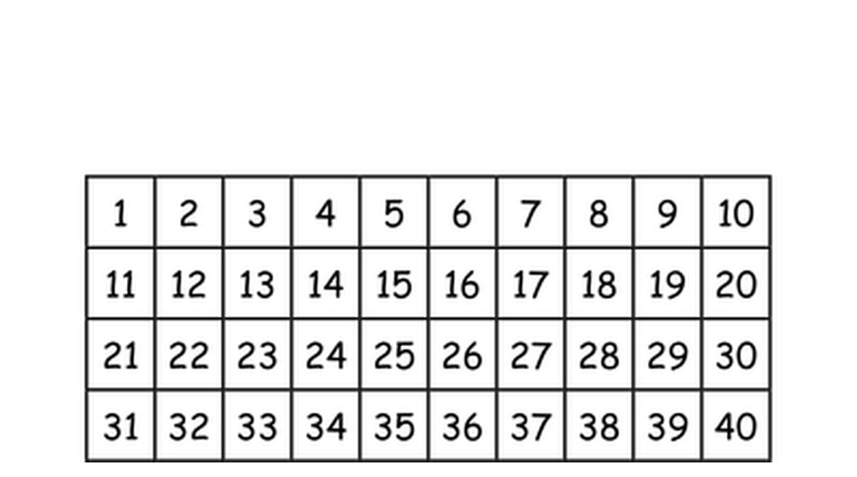
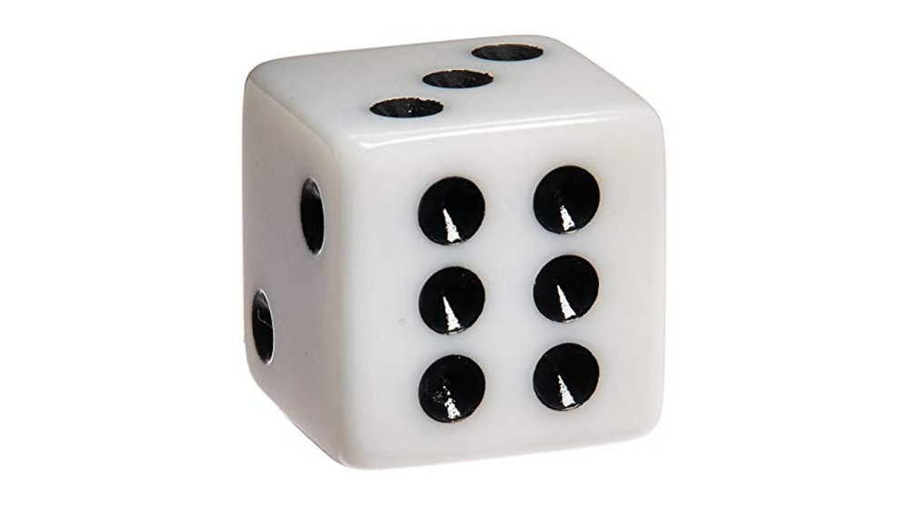
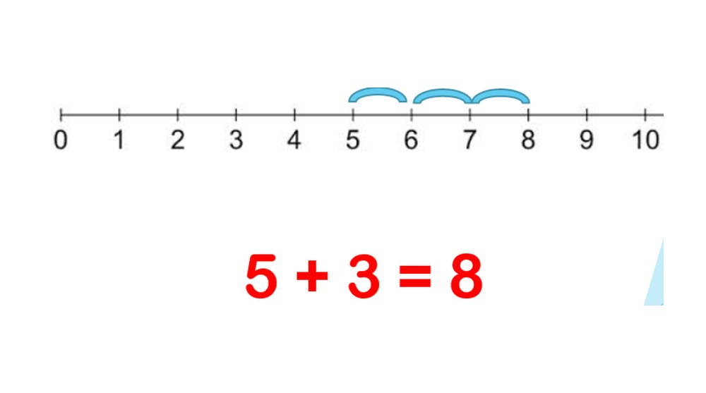
Resources we use in school
Your child will keep using all of these in Year 2, especially base 10 and the hundred square.
Cubes
Building numbers and towers of 10
Cube trains
15 is one ten and 5 ones
Ten frames and counters
Showing numbers to 10 and 20
Numicon
Seeing number bonds and patterns
Base 10 (Dienes)
Tens and ones up to 100
Hundred square
Counting, patterns and adding 10
Dice
Seeing amounts without counting
Number lines
Counting on and counting back
Notes:
These photos are from previous workshops. If you can, have the real resources on the tables for parents to handle. The cube train shows 15 as one ten and five ones, which is the idea behind most of our place value teaching.

Slide 8
Tens and ones: the key to Year 2
ACTIVITY
Children who really understand tens and ones find adding and subtracting much easier.
63
Your turn! Make 45 in three different ways
Use tens and ones.
45 = 40 + 5
45 = ? + ?
45 = ? + ?
Hint: what if you break a ten into ones?
6 tens and 3 ones
60 + 3
sixty-three
Compare: which sign goes in the circle?
47
74
< less than
> greater than
= equal to
"The 6 is worth 60 because it is in the tens place."
30 + 6
36
Notes:
Answers: 45 can be 40 + 5, 30 + 15, 20 + 25, 10 + 35, or 4 tens and 5 ones. Splitting numbers in different ways (not just tens and ones) is exactly what children need for subtracting later. Compare: 47 < 74, and 30 + 6 = 36. The 63 example comes from last year’s workshop.

Slide 9

If I know this, I also know ...
ACTIVITY
Year 2 children use facts they know to work out new ones, instead of counting.
10 − 7 = 3
7 + 3 = 10
10 − 3 = 7
I know
3 + 7 = 10
I know
3 + 7 = 10
30 + 70 = 100
13 + 7 = ?
23 + 7 = ?
3 + ? = 10
100 − 70 = ?
Your turn: fill in the dashed ones. What else do you know from 3 + 7 = 10?
Notes:
Answers: 13 + 7 = 20, 23 + 7 = 30, 100 − 70 = 30 and 3 + 7 = 10. Push for more: 7 + 13 = 20, 70 + 30 = 100, 30 + 7 = 37 (careful!). This is why number bonds to 10 from Year 1 are so important: one fact unlocks many.

Slide 10
Adding two-digit numbers
Children start with base 10, then draw it, then use a number line in their heads.
1 Tens, then ones
2 Number line: jump the tens, then the ones
20 + 10 = 30
4 + 3 = 7
30 + 7 = 37
+10
+
+3
24
34
37
24 + 13 = 37
"Start at 24. Jump 10 to 34. Jump 3 to 37."
3 Bridging 10: make the next ten first
38 + 5
5
38 + 2 = 40
40 + 3 = 43
"5 is 2 and 3. I use the 2 to make 40, then add the 3 that is left."
2
3
Notes:
Model all three. The number line is "empty": children only mark the numbers they need. Bridging 10 relies on number bonds: to get from 38 to 40 you need 2, and 5 is 2 and 3. If your child adds the ones first, that is fine too: what matters is that they understand tens and ones.

Slide 11

Subtracting: count back, or count up?
Year 2 children learn both, and choose the quicker one for each question.
Count back: 45 − 12 = 33
Count up: 52 − 47 = 5
−10
+3
−2
+2
33
35
45
47
50
52
"3 and 2 is 5. The difference is 5."
Your turn! Count back or count up?
61 − 58 61 − 20 73 − 69
Tip: if the numbers are close together, counting up is quicker.
Check it!
45 − 12 = 33
so 33 + 12 = 45
Adding undoes subtracting.
ACTIVITY
Notes:
Ask parents which method they would choose. 61 − 58: count up (3). 61 − 20: count back two tens (41). 73 − 69: count up (4). Parents often only know "take away"; finding the difference by counting up is very powerful. Checking with the inverse is a key Year 2 skill.

Slide 12

The bar model: drawing word problems
ACTIVITY
Word problems are often the hardest part. Drawing a bar shows whether to add or subtract.
Example
There are 45 sweets in a jar. 18 are red. The rest are yellow. How many are yellow?
Your turn! Draw the bar
Mum buys a lolly for 25p and a drink for 40p. How much does she spend altogether?
45 sweets
?
18 red
?
?
?
We know the whole and one part.
So we subtract: 45 − 18 = 27
27 sweets are yellow.
What do we know: the parts or the whole?
So do we add or subtract?
Parts known → add. Whole and one part known → subtract.
Notes:
The bar model is the "Draw it" stage for word problems. Answer: 25p + 40p = 65p; the parts are known, so we add. Children use bars right through primary school, so it is worth parents getting used to them.

Slide 13

Multiplying: groups, arrays and times tables
Year 2 children learn the 2, 5 and 10 times tables, and count in 3s.
Repeated addition
Arrays: turn it around
4 rows of 6
4 × 6 = 24
6 columns of 4
6 × 4 = 24
3 + 3 + 3 + 3 = 12
4 groups of 3 = 12
4 × 3 = 12
"Multiplying can be done in any order."
Count in ...
2s: 2, 4, 6, 8, 10 ... 24
5s: 5, 10, 15 ... 60
10s: 10, 20, 30 ... 120
3s: 3, 6, 9, 12 ... 30
Notes:
The 4 groups of 3 example comes from last year’s workshop, and the 4 × 6 array from our calculation policy. Children learn that multiplication can be done in any order (commutative), but division cannot. Hit the Button on Topmarks is excellent for times tables practice.

Slide 14

Dividing: sharing and grouping
Two different ways to think about the same calculation: 10 ÷ 2 = 5.
Sharing
Grouping
"10 sweets shared between 2 friends is 5 each."
10 ÷ 2 = 5
"How many groups of 2 can I make from 10?"
10 ÷ 2 = 5
Use what you know: if 5 × 2 = 10, then 10 ÷ 2 = 5 and 10 ÷ 5 = 2.
At home: share out snacks, cards or Lego. "Is it fair? Are any left over?"
Notes:
The sweets example comes from our calculation policy. Sharing (how many in each group?) and grouping (how many groups?) give the same answer but feel very different to children, so they practise both.

Slide 15
Fractions: equal parts
Year 2 children find halves, thirds and quarters of shapes and amounts.
Of shapes
Of amounts: ¾ of 12 = 9
12
3
3
3
3
1/2
1/3
1/4
2/4
3/4
12 in 4 equal parts is 3 in each part.
Three parts: 3 + 3 + 3 = 9
2/4 is the same as 1/2!
At home
Cut pizza, cake or toast: "Are the pieces equal? What fraction is each piece?"
Share 12 grapes into 4 equal groups. "What is a quarter of 12? Three quarters?"
Fold paper into halves and quarters, and colour some parts.
Notes:
The three quarters of 12 example comes from last year’s workshop. The key idea is that the parts must be equal: a shape cut into 4 unequal pieces is not in quarters.

Slide 16
Also in Year 2: money, time and measures
These are best learnt through real life, so they are perfect for home.
Money
Time
Measures
20p
20p
10p
= 50p
11
12
1
11
12
1
10
2
10
2
9
3
9
3
0
5
10
15
50p
8
4
8
4
7
6
5
7
6
5
Make amounts and give change
To 5 minutes, quarter past and to
cm, m, g, kg, ml and litres
At home
Pay for small things with coins: "How else could we make 50p?"
Give change from £1 by counting up.
At home
Ask "What time is it?" through the day.
Count round the clock in 5s.
At home
Measure toys with a ruler and order them.
Bake together: weigh and pour.
Notes:
Time to five minutes is one of the trickiest parts of Year 2, and a watch or a kitchen clock with hands really helps. The clocks show quarter past 4 and quarter to 10.

Slide 17





Questions to ask your child
Talking is the "Say it" part of maths. These questions come from our calculation policy.
What do the digits mean?
How do you know?
Are you counting forwards or backwards?
Does it matter which order the numbers go in?
Can you check it another way?
What do you already know that could help?
Words to use
tens
ones
partition
add
subtract
difference
count on
count back
inverse
equal groups
multiply
divide
array
half
third
quarter
greater than
less than
Notes:
Encourage parents to ask "How do you know?" even when the answer is right. "Does it matter which order?" is a lovely question: yes for subtracting and dividing, no for adding and multiplying.

Slide 18

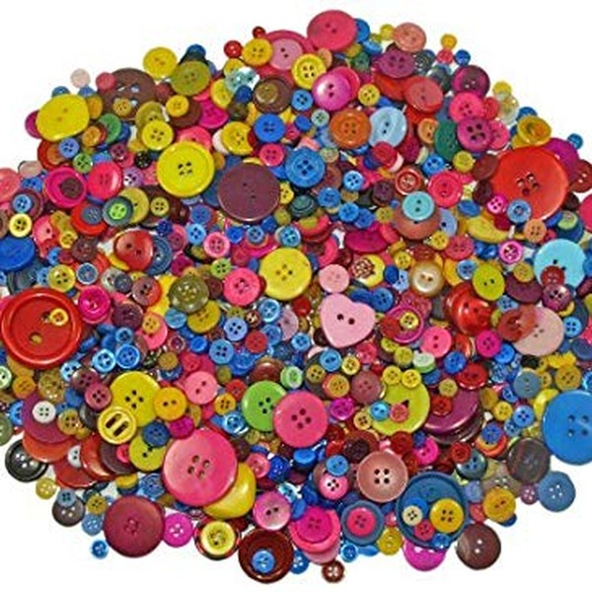
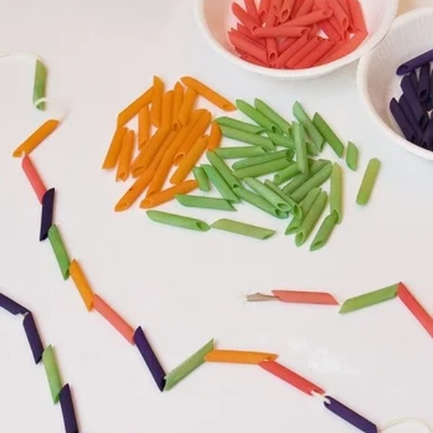
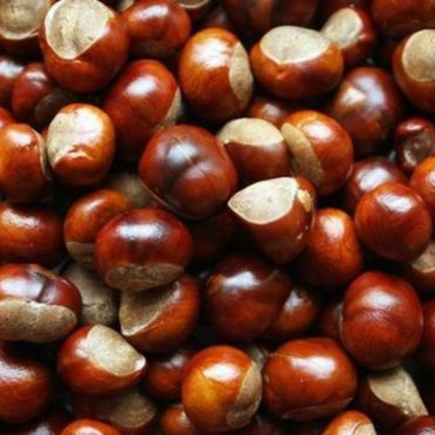
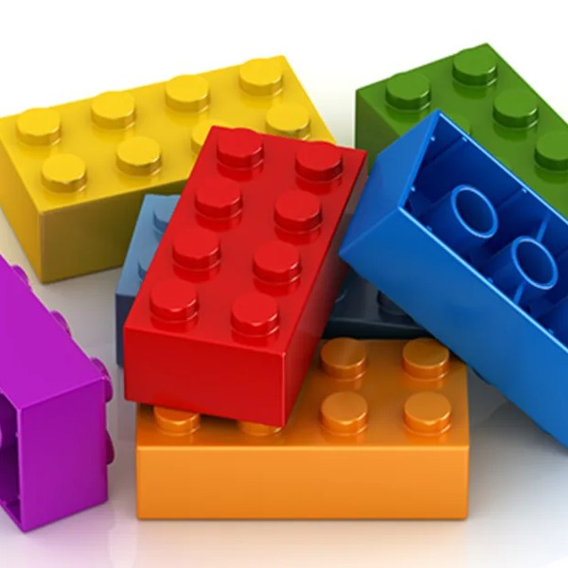
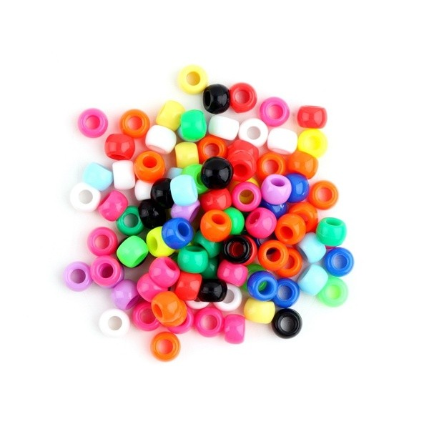
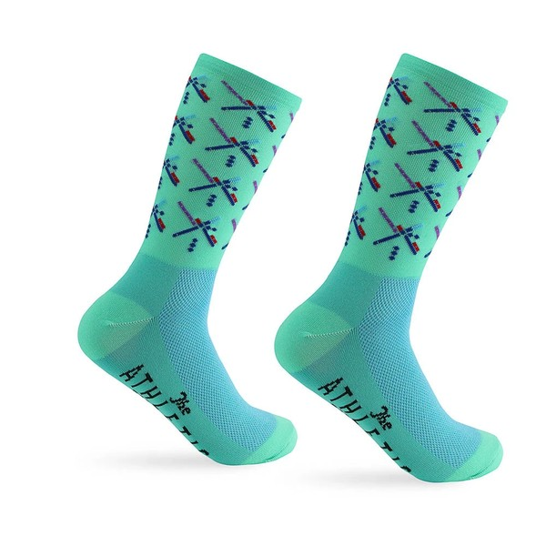
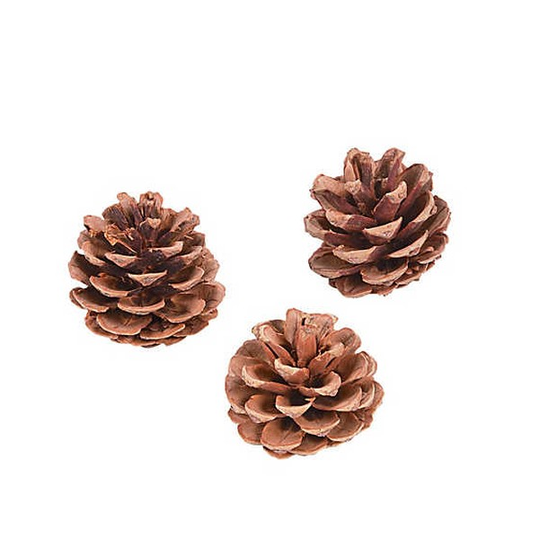
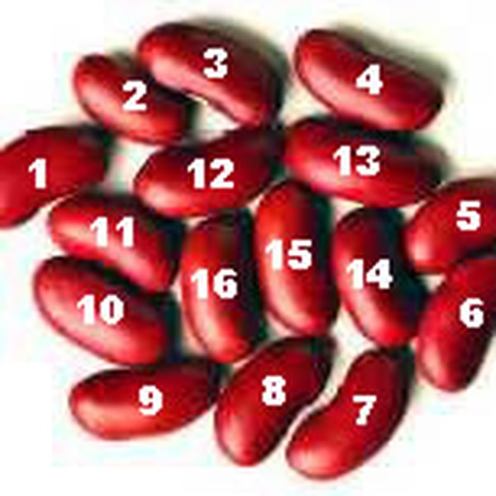
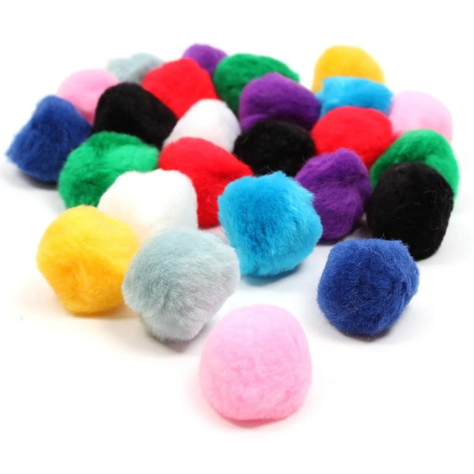
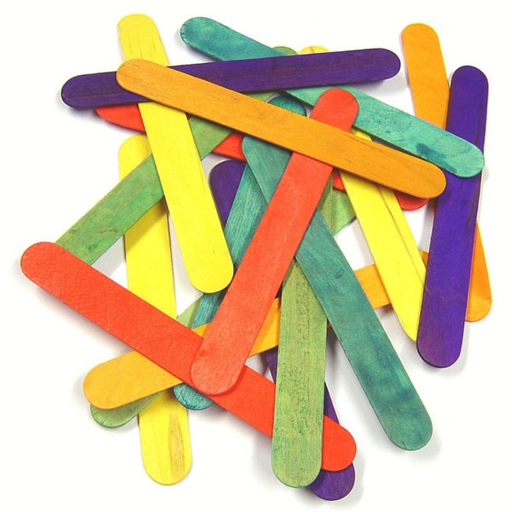
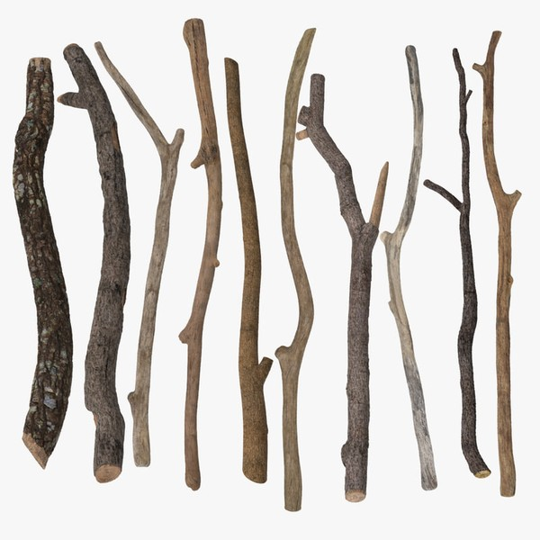
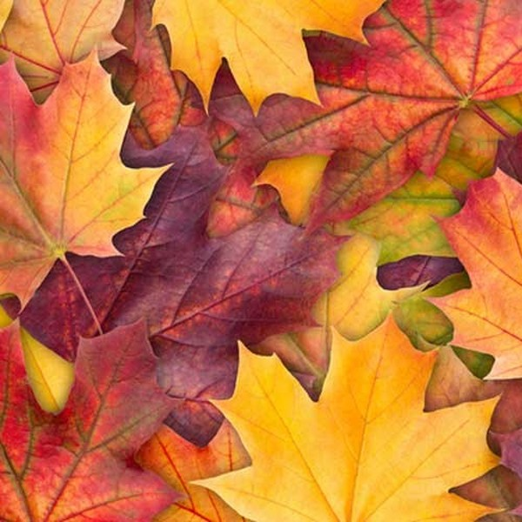
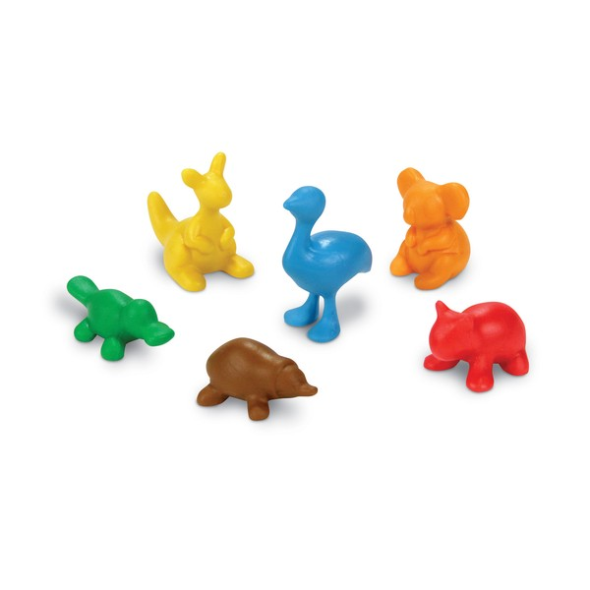
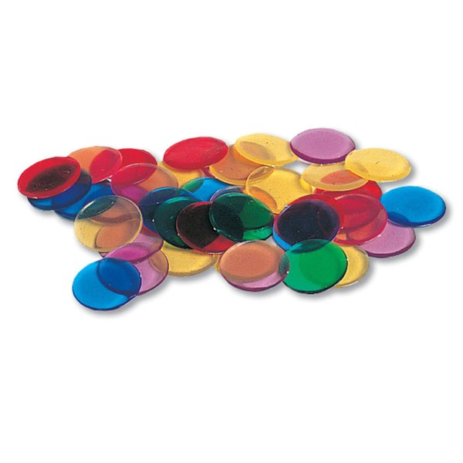
Objects to count at home
Anything small can be counted, grouped, shared or made into patterns. Collect a few in a box!
Buttons
Pasta
Conkers
Lego
Beads
Socks (count in 2s)
Pine cones
Dried beans
Pom-poms
Lolly sticks
Twigs
Leaves
Small toys
Counters
Use them to: count, make groups of 2, 5 or 10, share fairly, make patterns, compare "more" and "fewer", and act out number stories.
Notes:
These photos are from previous workshops. Natural objects such as conkers, leaves and pine cones are free and children love collecting them. Small objects are a choking hazard for younger siblings, so keep them in a box.

Slide 19
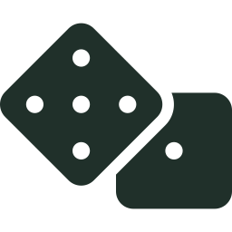


Games to play at home
ACTIVITY
Five minutes, a few times a week. Let us try one now!
Biggest number
Pairs to 100
Shop and change
Times table hunt
Roll two dice. Make the biggest two-digit number you can. Who wins? Then try the smallest.
Say a multiple of 10. Your child says what goes with it to make 100: "30!" "70!"
Price toys up to £1. Pay with coins and count up to give change.
Count in 5s round a clock, in 2s up the stairs, in 10s with 10p coins.
You need: two dice
You need: nothing!
You need: some coins
You need: a clock or coins
Maths is everywhere: talk about it!
door numbers
bus numbers
baking and weighing
shopping and change
board games
telling the time
sharing snacks
measuring toys
Notes:
Play Biggest number with the parents now using two dice. Ask "Why did you put that digit in the tens place?" That is place value reasoning.

Slide 20






Useful websites and apps
All free unless stated. Short and often is best: ten minutes is plenty.
Hit the Button (Topmarks)
Quick-fire times tables and number bonds. Great for the 2, 5 and 10 times tables.
topmarks.co.uk
1-Minute Maths
Free White Rose Maths app. Short tasks on adding, subtracting, multiplying and dividing.
App Store and Google Play
Numberblocks
CBeebies series made with maths teaching experts. Try: Two Times Shoe Shop and The Many Friends of Twenty.
CBeebies and BBC iPlayer
Busy Things
Our school subscription. Log in through MyUSO.
Login details from your class teacher
Toy Theater
Free virtual base 10, number lines and hundred squares.
toytheater.com
ICT Games
Games for place value, adding, subtracting and money.
ictgames.com
Notes:
Hit the Button is a firm favourite for times tables. The later Numberblocks series cover times tables and part-whole for bigger numbers, so they are still useful in Year 2.

Slide 21



Your Year 2 maths toolkit
Little and often is the secret. Try some of these every week.
Talk about tens and ones.
Keep practising number bonds to 10, 20 and 100.
Ask "What do you already know?"
Draw a bar for word problems.
Practise 2, 5 and 10 times tables.
Check with the inverse.
Use real money and real clocks.
Ask "How do you know?"
Notes:
A one-page summary. Parents may like to screenshot or print this slide from the website.

Slide 22

Any questions?
Thank you for coming, and for everything you do to help your child with maths.
You are always welcome to speak to your child’s class teacher about their maths.
These slides are on our website: rgreeninf.brent.sch.uk
Notes:
Open the floor to questions.

